Slide 1

CHAPTER 9
COUNTING AND PROBABILITY
Copyright © Cengage Learning. All rights reserved.

Slide 2

9.7
Pascal’s Formula and
the Binomial Theorem
Copyright © Cengage Learning. All rights reserved.

Slide 3

Pascal’s Formula and the Binomial Theorem
In this section we derive several formulas for values of
The most important is Pascal’s formula, which is the basis for Pascal’s triangle and is a crucial component of one of the proofs of the binomial theorem.
We offer two distinct proofs for both Pascal’s formula and the binomial theorem. One of them is called “algebraic” because it relies to a great extent on algebraic manipulation, and the other is called “combinatorial,” because it is based on the kind of counting arguments we have been discussing in this chapter.

Slide 4
Pascal’s Formula

Slide 5


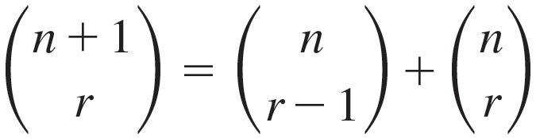
Pascal’s Formula
Pascal’s formula, named after the seventeenth-century French mathematician and philosopher Blaise Pascal, is one of the most famous and useful in combinatorics (which is the formal term for the study of counting and listing problems).
It relates the value of
to the values of
Specifically, it says that
whenever n and r are positive integers with r ≤ n.

Slide 6


Pascal’s Formula
This formula makes it easy to compute higher combinations
in terms of lower ones: If all the values of
are known,
then the values of
can be computed for every integer r such that 0 < r ≤ n.

Slide 7
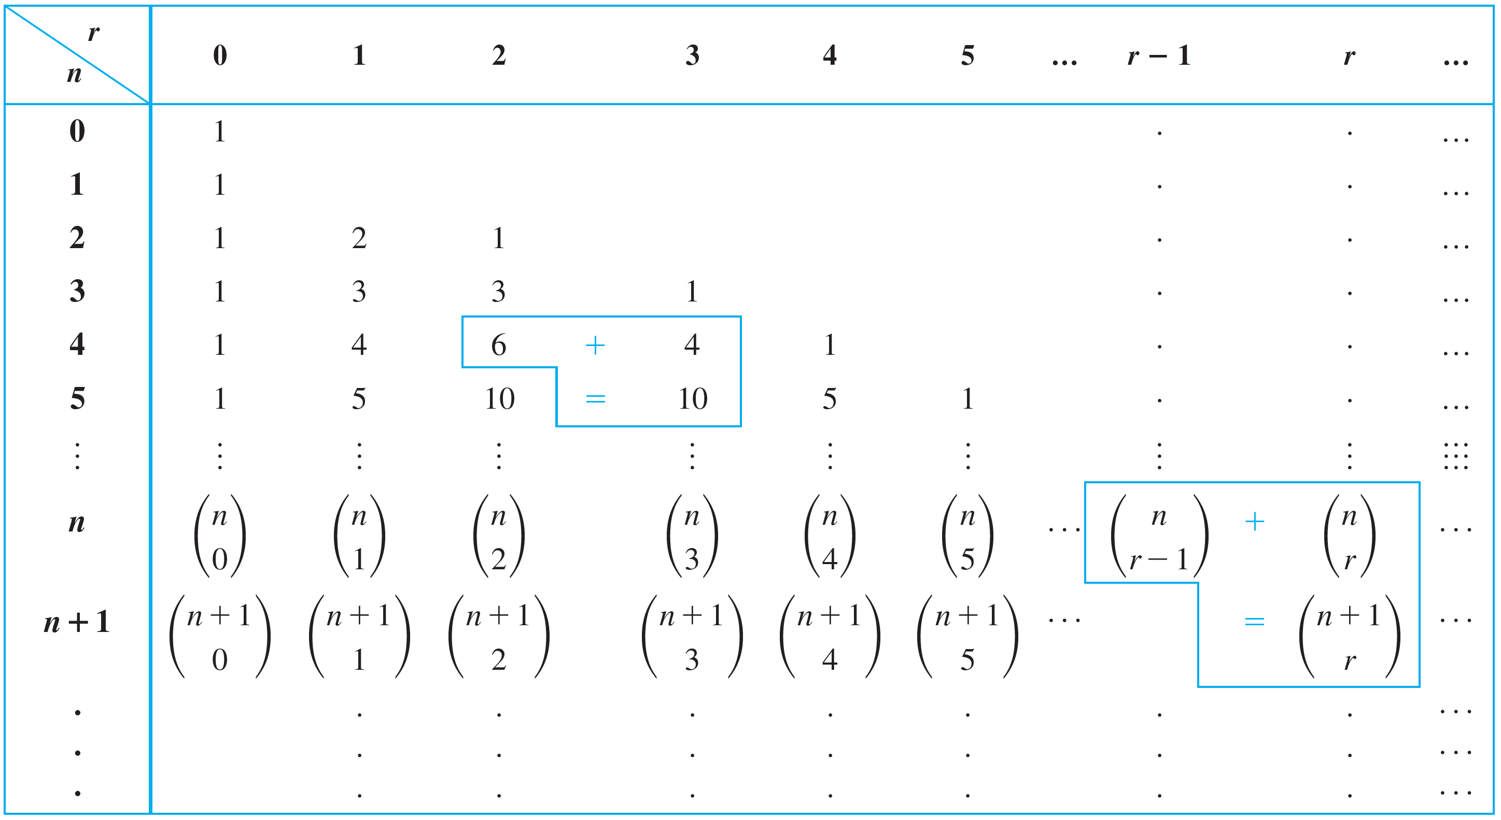

Pascal’s Formula
Pascal’s triangle, shown in Table 9.7.1, is a geometric version of Pascal’s formula.
Pascal’s Triangle for Values of
Table 9.7.1

Slide 8
Pascal’s Formula
Sometimes it is simply called the arithmetic triangle because it was used centuries before Pascal by Chinese and Persian mathematicians.
But Pascal discovered it independently, and ever since 1654, when he published a treatise that explored many of its features, it has generally been known as Pascal’s triangle.

Slide 9

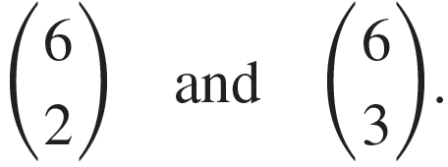
Example 9.7.3 – Calculating
Using Pascal’s Triangle
Use Pascal’s triangle to compute the values of

Slide 10
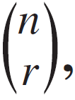



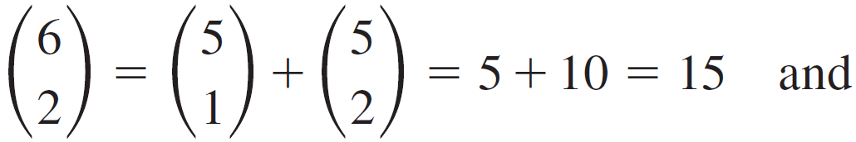
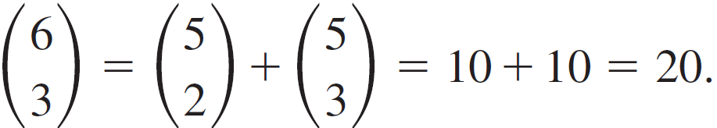
Example 9.7.3 – Solution
By construction, the value in row n, column r of Pascal’s
triangle is the value of
for every pair of positive integers
n and r with r ≤ n. By Pascal’s formula,
can be
computed by adding together
which are
located directly above and above left of
Thus,

Slide 11
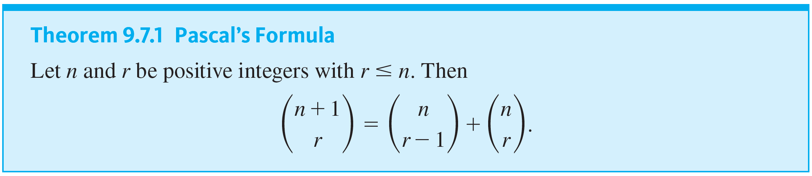
Pascal’s Formula

Slide 12


Example 9.7.4 – Deriving New Formulas from Pascal’s Formula
Use Pascal’s formula to derive a formula for
in terms
of values of
Assume n and r are nonnegative integers and 2 ≤ r ≤ n.

Slide 13
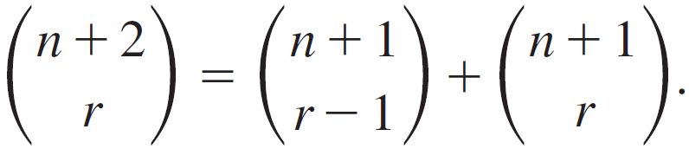

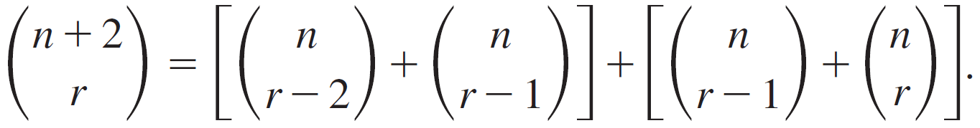
Example 9.7.4 – Solution
By Pascal’s formula,
and substitute into the above to obtain
Now apply Pascal’s formula to

Slide 14
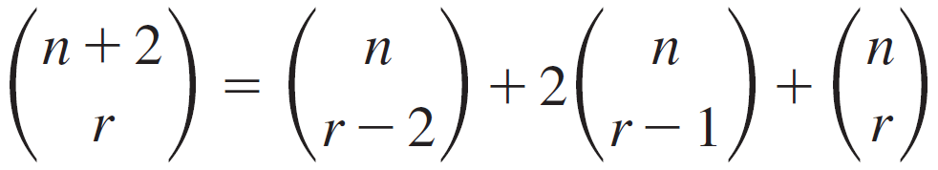
Example 9.7.4 – Solution
continued
Combining the two middle terms gives
for all nonnegative integers n and r such that 2 ≤ r ≤ n.

Slide 15
The Binomial Theorem

Slide 16

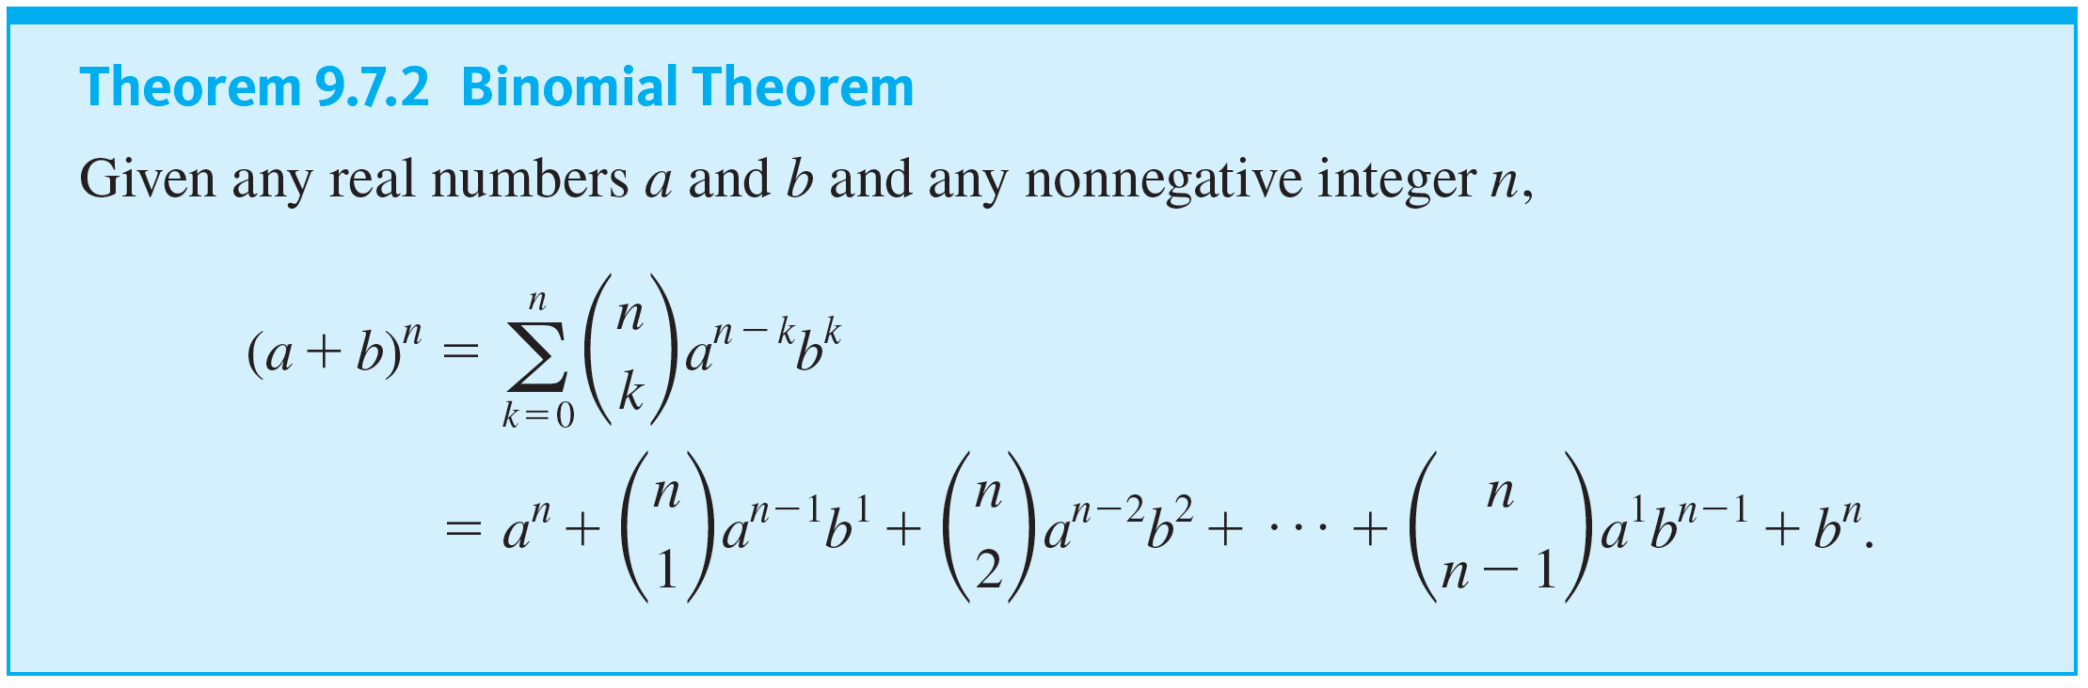
The Binomial Theorem
In algebra a sum of two terms, such as a + b, is called a binomial. The binomial theorem gives an expression for the powers of a binomial
for each nonnegative integer n and all real numbers a and b.

Slide 17


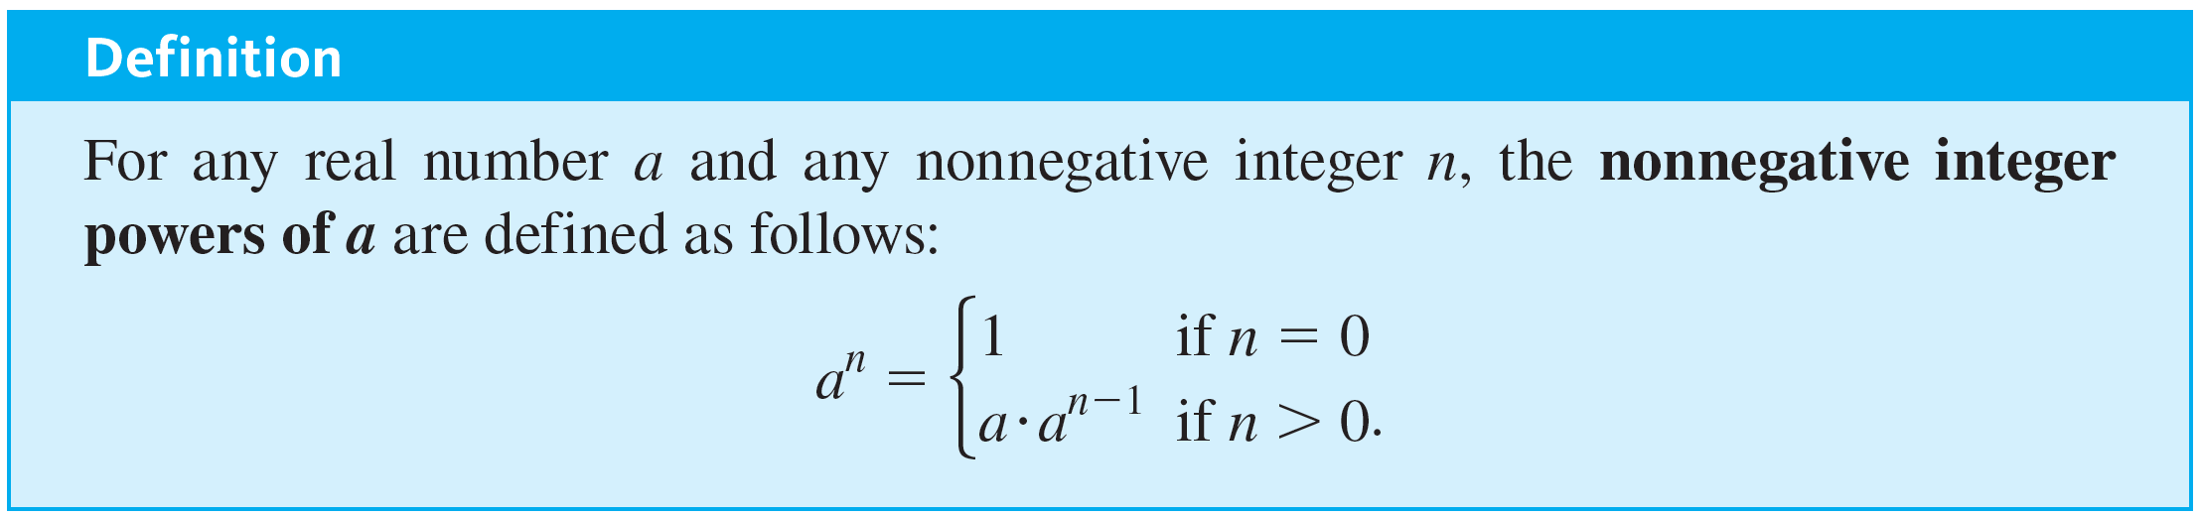
The Binomial Theorem
Note that the second expression equals the first because
for all nonnegative integers n, since

Slide 18

Example 9.7.5 – Substituting into the Binomial Theorem
Expand the following expressions using the binomial theorem:

Slide 19
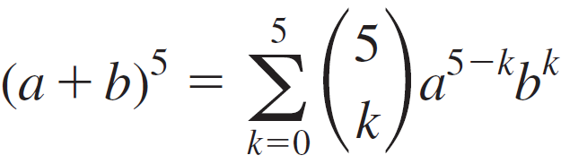
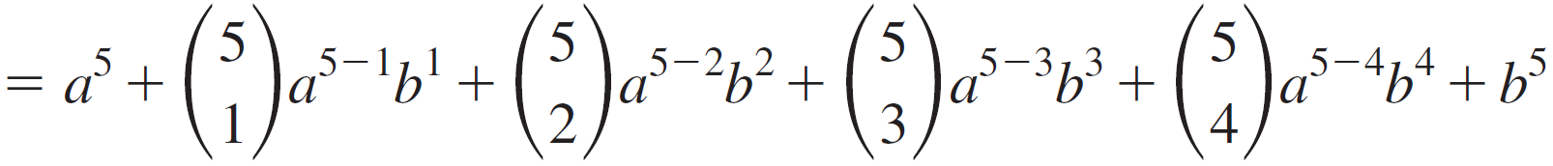
Example 9.7.5 – Solution
a.

Slide 20

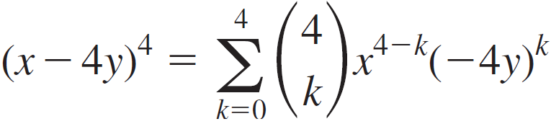
Example 9.7.5 – Solution
continued
So let a = x and
b = (−4y), and substitute into the binomial theorem.
b. Observe that

Slide 21
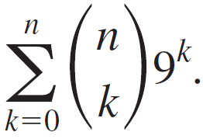
Example 9.7.8 – Using the Binomial Theorem to Simplify a Sum
Express the following sum in closed form (without using a summation symbol and without using an ellipsis … ):

Slide 22
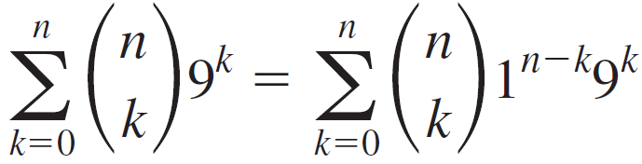


Example 9.7.8 – Solution
When the number 1 is raised to any power, the result is still 1. Thus
by the binomial theorem with a = 1 and b = 9

